Slide 1

Machine learning to predict an inverter's phase voltage
Group 4

Slide 2
introduction
For speed control of an induction motor, the variable under control are the phase voltages. Typically, feedback control requires the measurement of the control variable, which is subtracted from a reference, creating an error signal that can be fed to a controller.
In the motor control context, however, the phase voltages typically are not measured due to the expense and complexity of doing so. Rotor speed is a much more easily measured quantity, and this is typically what is measured in practical applications of electric motors.
To generate the error signal required for feedback control of the motor, a model relating rotor speed to phase voltage can be employed.
Data-driven model to predict phase voltage
Notes:
For speed control of an induction motor, the variable under control are the phase voltages. Typically, feedback control requires the measurement of the control variable, which is subtracted from a reference, creating an error signal that can be fed to a controller.
In the motor control context, however, the phase voltages typically are not measured due to the expense and complexity of doing so. Rotor speed is a much more easily measured quantity, and this is typically what is measured in practical applications of electric motors.
To generate the error signal required for feedback control of the motor, a model relating rotor speed to phase voltage can be employed.
The creation of a data-driven model between rotor speed and phase voltage is the objective of this project.

Slide 3
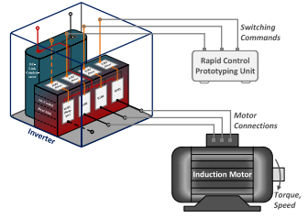
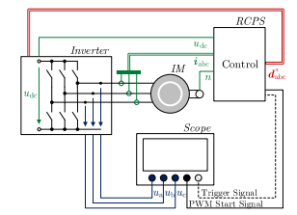
DATASET

Slide 4
Target
Predict Phase Voltages Instead of Measuring them

Slide 5
Projected procedure
Regression

Slide 6
Thank you

